Slide 1
Automated Business Components (BC)
Prepared by Alpesh, Yogesh, Tarun, Sahid.

Slide 2
Automated Business Components (BC)
A business process test is composed of a serial flow of business components, designed to test a specific business process of an application. A component can or cannot pass data to a subsequent component.
A business component is an easily-maintained, reusable unit comprising one or more steps that perform a specific task.
Components are parts of a business process that has been broken down into smaller parts. Components are comprised of steps.
For example, the login component's first step may be to open the application. Its second step could be entering a user name. Its third step could be entering a password, and its fourth step could be clicking the Enter button.

Slide 3
Scripted Component.
A scripted component is an automated component that can contain programming logic. Scripted components share functionality with both test actions and business components.
For example, you can use the Keyword View, the Expert View, and other QuickTest tools and options to create, view, modify, and debug scripted components in QuickTest. Due to their complexity, scripted components can be edited only in QuickTest.

Slide 4
Automation Component
Using HP ALM/QC we create Automated component using one of the two approach.
keyword-driven automated components
Scripted automated components
Automated component for both the approach are same only approach are different.
For keyword-driven automated components: A graphical format in which to create and modify automated keyword-driven business component steps. This format is called the Keyword View. The steps in the Keyword View represent the operations that are performed automatically on your application when you run the component using a testing tool.
For scripted automated components: A way to launch the relevant testing tool. When working with scripted components, the component steps can be viewed or modified only within the relevant testing tool.

Slide 5
Automation Component
Automation Component are created either by subject matter expert or by automation engineer.
Listed below are important Component can be created or added to Business Component.
Object Repository.
Function Libraries.
Recovery Scenarios
And other component as required for testing Business Component.

Slide 6
Automation Component
The BPT Resources folder contains all the QuickTest resources available for business components in the project, and includes the following subfolders:
Application Areas. Provides all of the settings and resources required to create the content of keyword-driven business components for a particular application or part of an application. The application area typically contains all the items contained in the folders listed below.
Libraries. Contains all the function libraries available for business components in the QuickTest project. Function libraries provide customized operations for business components. The Libraries folder contains the default function library containing operations that can be used when creating business component steps. The automation engineer can store additional function libraries in this folder.

Slide 7
Automation Component
Object Repositories. Contains all the shared object repository files available for business components in the QuickTest project. Object repository files define the test objects that can be used in the steps of a business component.
Recovery Scenarios: Contains all the recovery scenario files available for business components in the QuickTest project. Recovery scenarios define special operations to recover from errors and unexpected events during the component run. By default, the Recovery Scenarios folder contains the DefaultWeb.qrs file, which is a recovery scenario file that can be used in the Web environment.
All the above component are created using QTP. And all the component added to the Area created for Business Process. User can Create/View/Edit/Delete these component as required and this area is associated with Business component.
Note: Each business Component can be associated with Only one application area .

Slide 8
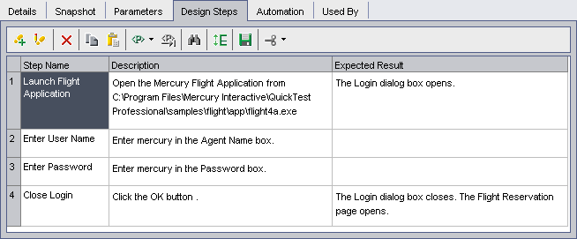
Converting the Manual Business Component to Automated
Creating Business Components
Note: Application is already Developed and Manual steps are already created.
In the Business Components module, select the Login component in the component tree, and click the Design Steps tab. The Design Steps tab opens.

Slide 9
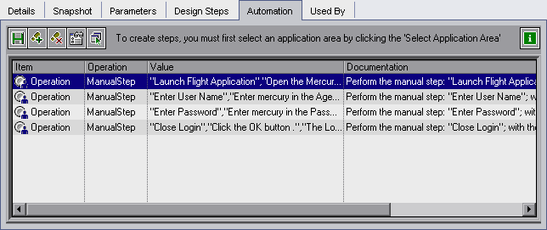
Converting the Manual Business Component to Automated
Automate the component.
Click the Automate component toolbar button.
Select QuickTest Keyword-Driven from the list and click Yes in the warning message. The component is converted to an automated QuickTest component.
Click OK in the information message and then click the Automation tab.
The steps appear as manual step operations in the Automation tab.

